Slide 1
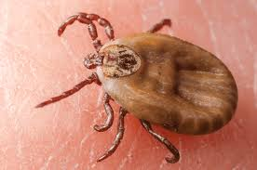
Pest Identification Activity
Lone Star Tick
Brown Dog Tick
Harlequin Cabbage Bug
Brown Marmorated Stink Bug
Notes:
B

Slide 2
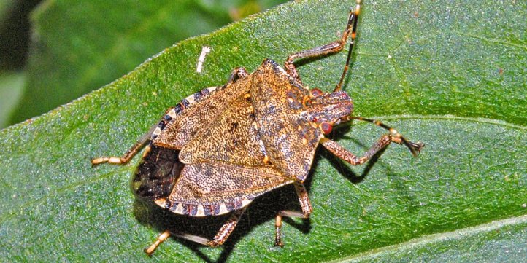
Pest Identification Activity
Common Weevil
Brown Marmorated Stink Bug
Squash Bug
Moth
Notes:
B

Slide 3
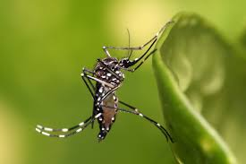
Pest Identification Activity
Aedes Aegypti Mosquito
Asian Tiger Mosquito
Culex Mosquito
Yellow Fever Mosquito
Notes:
a

Slide 4
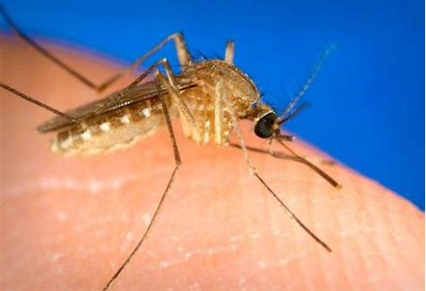
Pest Identification Activity
Aedes Aegypti Mosquito
Anopheles Mosquito
Culex Mosquito
Yellow Fever Mosquito
Notes:
A

Slide 5
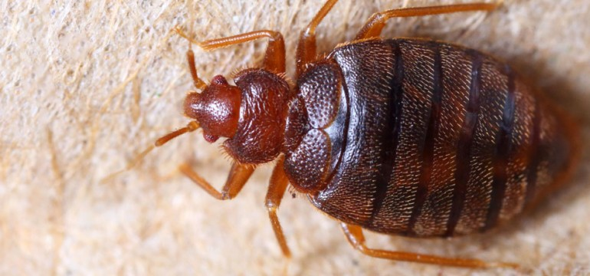
Pest Identification Activity
Brown Dog Tick
Bat Bug
Bed Bug
Spider Beetle
Notes:
B

Slide 6
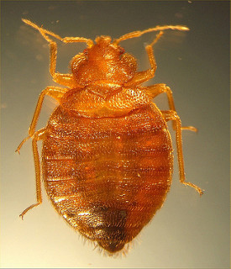
Pest Identification Activity
Brown Dog Tick
Bat Bug
Bed Bug
Spider Beetle
Notes:
C

Slide 7
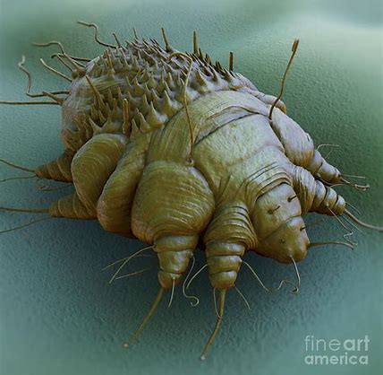
Pest Identification Activity
Brown Dog Tick
Scabie Mite
Moth
Flea
Notes:
C

Slide 8
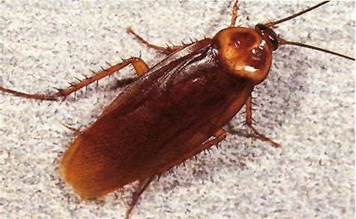
Pest Identification Activity
German Cockroach
American Cockroach
Cricket
June Bug
Notes:
B

Slide 9
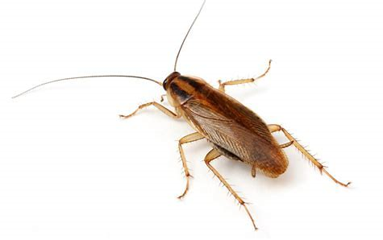
Pest Identification Activity
Asian Longhorned Beetle
American Cockroach
Water Bug
German Cockroach
Notes:
D

Slide 10
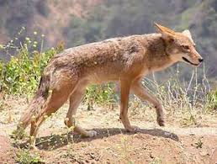
Pest Identification Activity
The Rez Dog
Coyote
Red Fox
German Shepard
Notes:
B

Slide 11
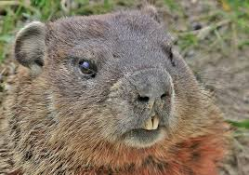
Pest Identification Activity
Groundhog
Norway Rat
Prairie Dog
Gopher
Notes:
D

Slide 12
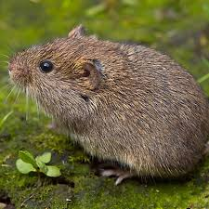
Pest Identification Activity
House Mouse
Vole
Mole
Shrew
Notes:
B

Slide 13
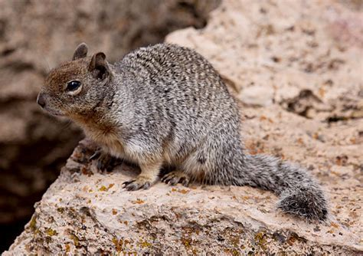
Pest Identification Activity
House Mouse
Vole
Chipmunk
Rock Squirrel
Notes:
D

Slide 14
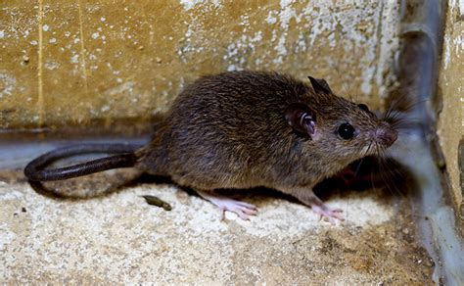
Pest Identification Activity
House Mouse
Roof Rat
Vole
Shrew
Notes:
B

Slide 15
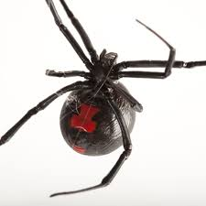
Pest Identification Activity
Black Widow
Red Widow
Black House Spider
Brown Recluse
Notes:
A

Slide 16
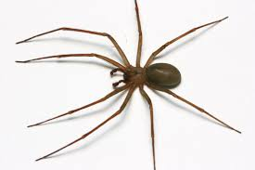
Pest Identification Activity
Brown Widow
Brown Recluse
House Spider
Hobo Spider
Notes:
B

Slide 17
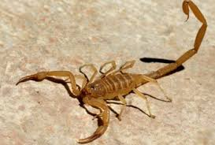
Pest Identification Activity
Forest Scorpion
Three Striped Scorpion
Arizona Hairy Scorpion
Arizona Bark Scorpion
Notes:
D

Slide 18
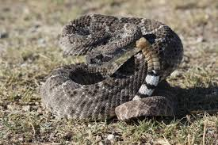
Pest Identification Activity
Western Diamondback Rattlesnake
Gopher or Bullsnake
Timber Rattlesnake
Eastern Mud Snake
Notes:
A

Slide 19
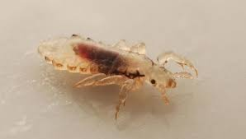
Pest Identification Activity
Aphid
Flea
Head Lice/Louse
Bed Bug
Notes:
c

Slide 20
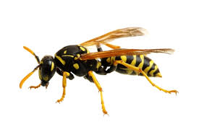
Pest Identification Activity
Wasp
Honey Bee
Africanized Bee
Bumble Bee
Notes:
A

Slide 21
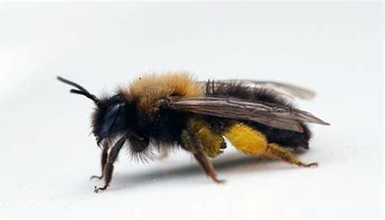
Pest Identification Activity
Wasp
Honey Bee
Africanized Bee
Bumble Bee
Notes:
C

Slide 22
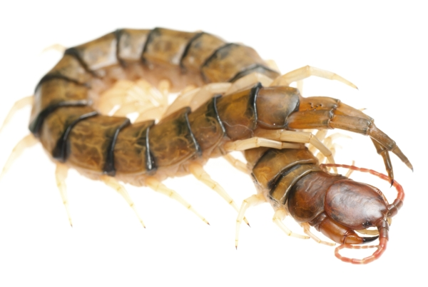
Pest Identification Activity
Millipede
Earth Worm
Centipede
Silverfish
Notes:
c

Slide 23
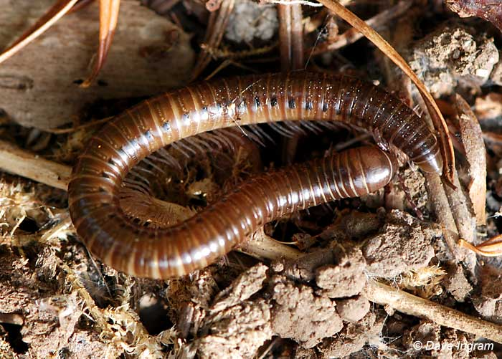
Pest Identification Activity
Millipede
Earth Worm
Centipede
Silverfish
Notes:
A

Slide 24
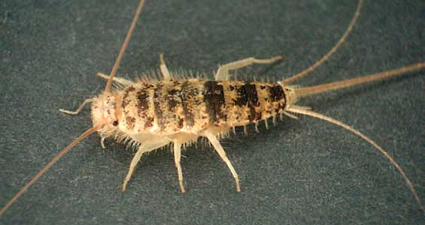
Pest Identification Activity
Millipede
Earth Worm
Centipede
Silverfish
Notes:
D

Slide 25
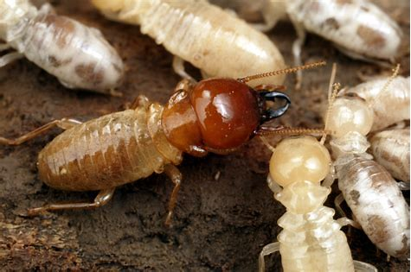
Pest Identification Activity
Cockroach Nymph
Queen Ant
Termite
Silverfish
Notes:
C

Slide 26
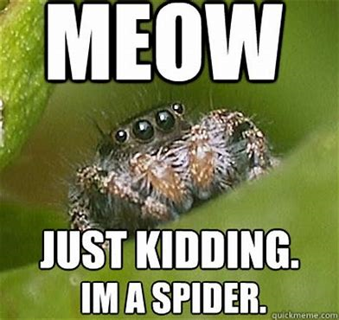
Pest Identification Activity
Notes:
D

